Slide 1
PPT Presentation Netflix
NETFLIX
Shankar Hooda

Slide 2
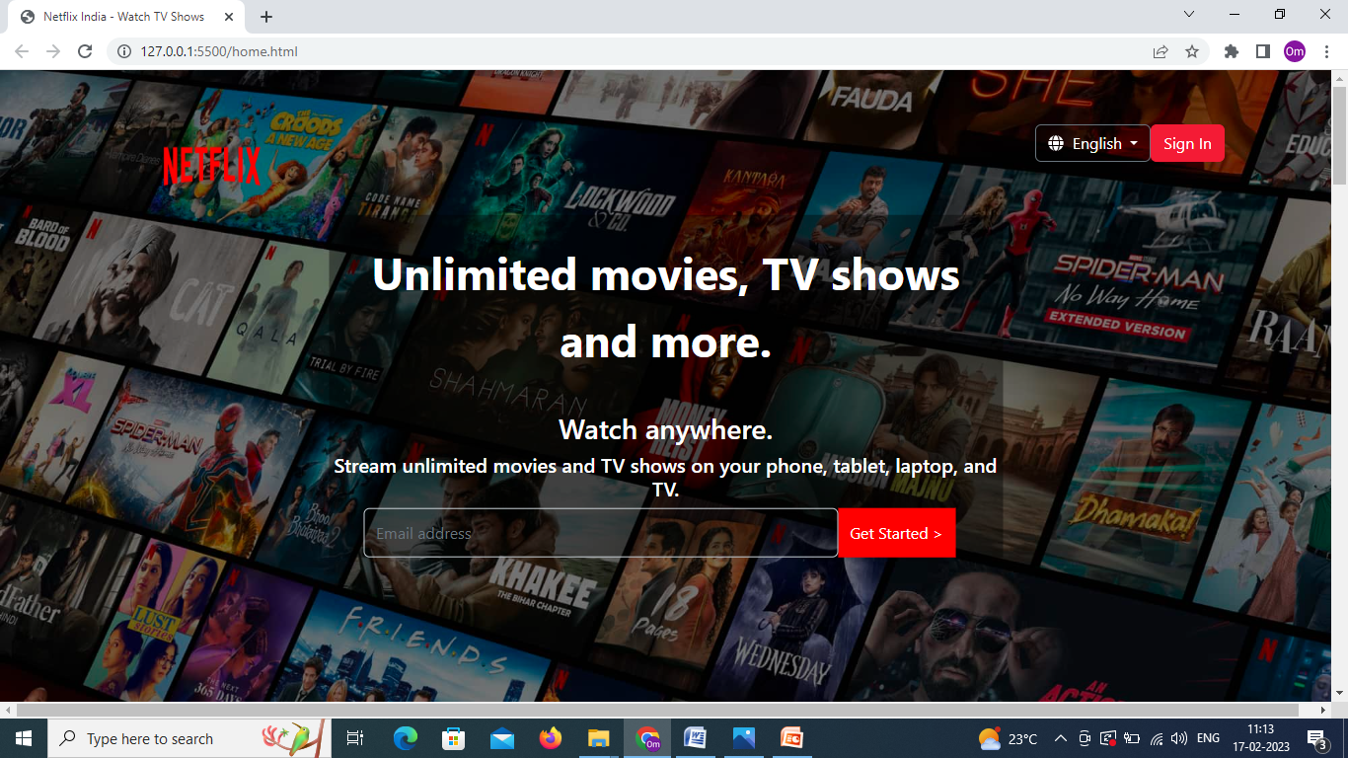
Home Page (Netflix Home_Page)

Slide 3
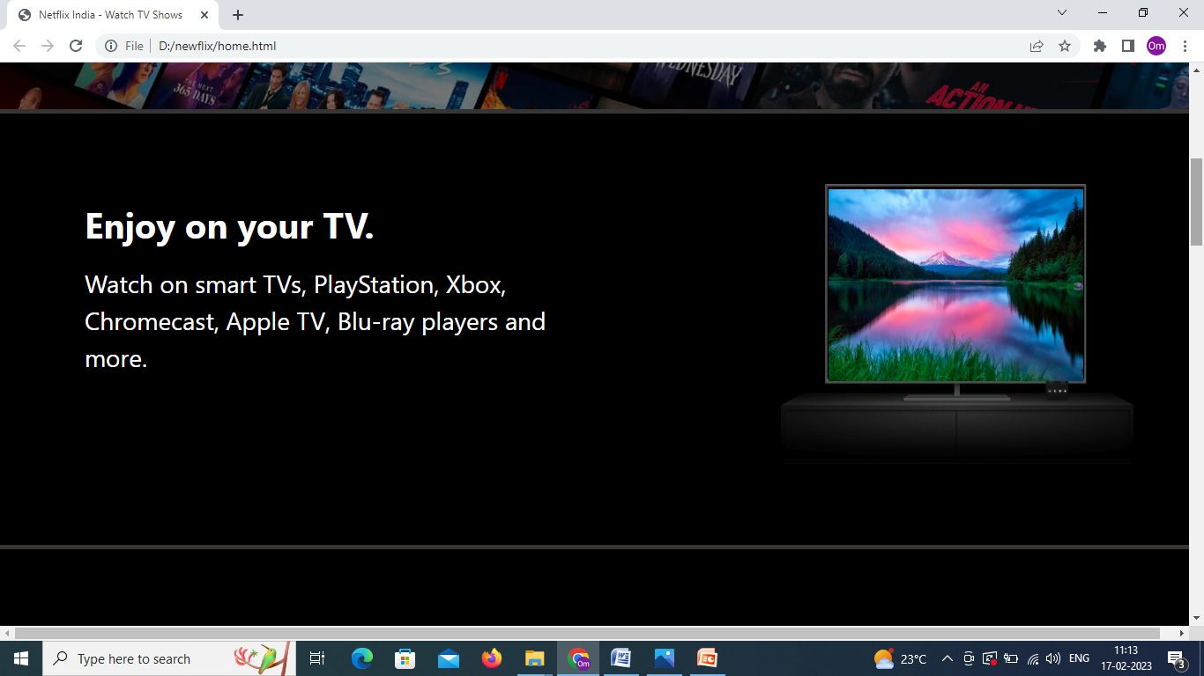
Content (1)

Slide 4
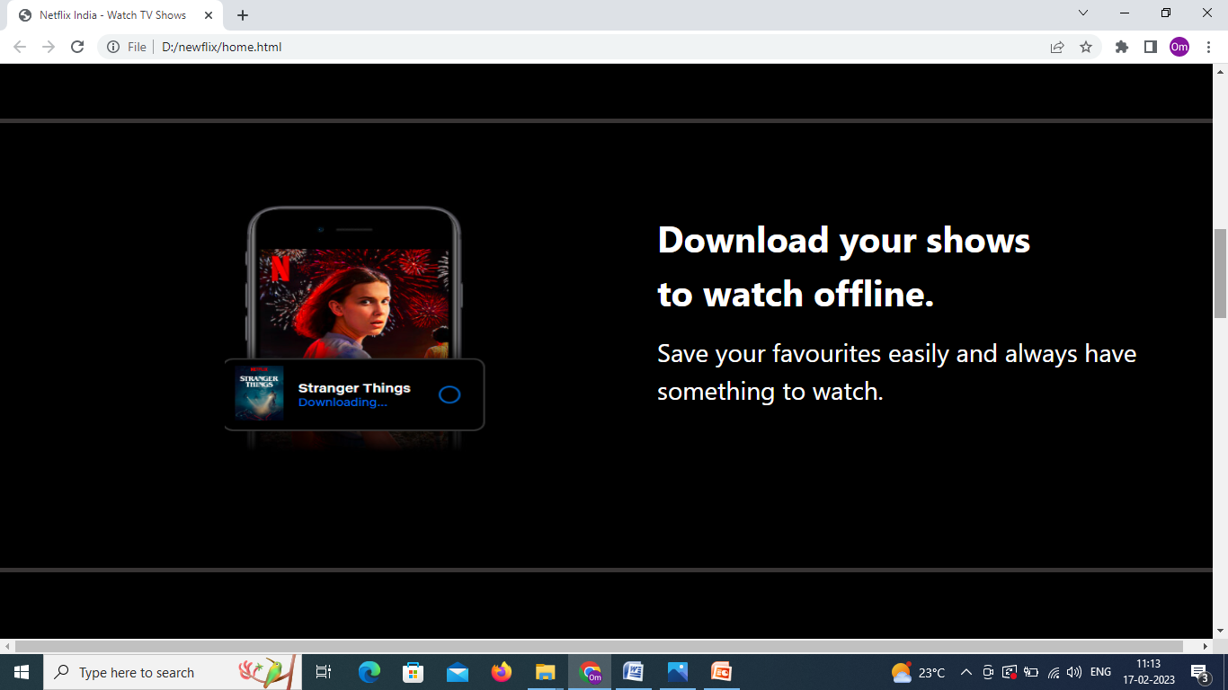
Content (2)

Slide 5
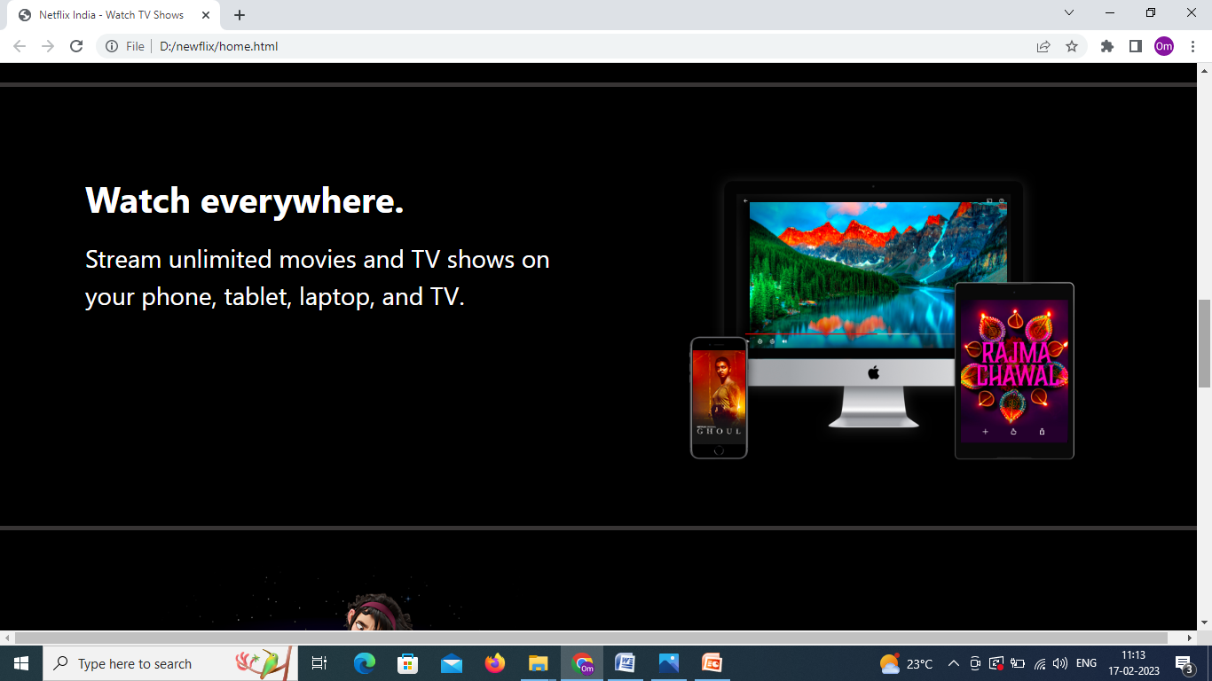
Content (3)

Slide 6
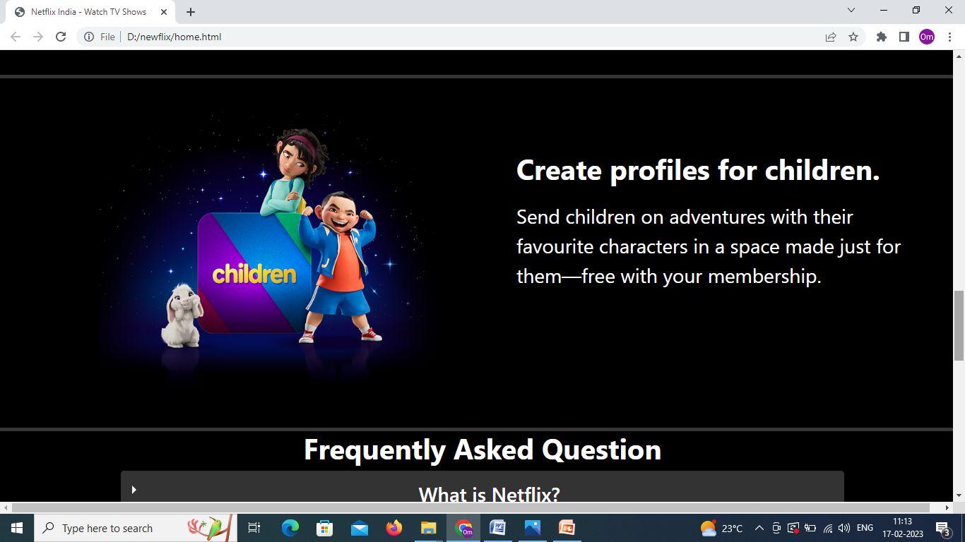
Content (4)

Slide 7
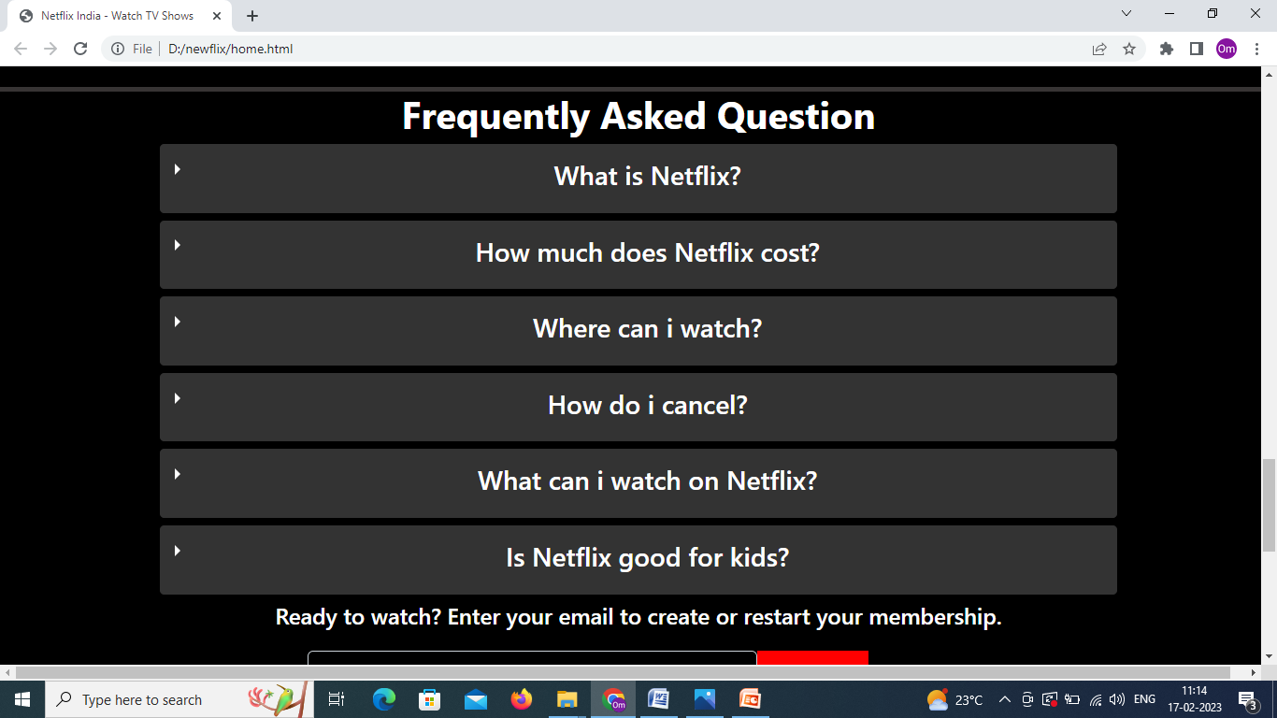
Content (5)

Slide 8
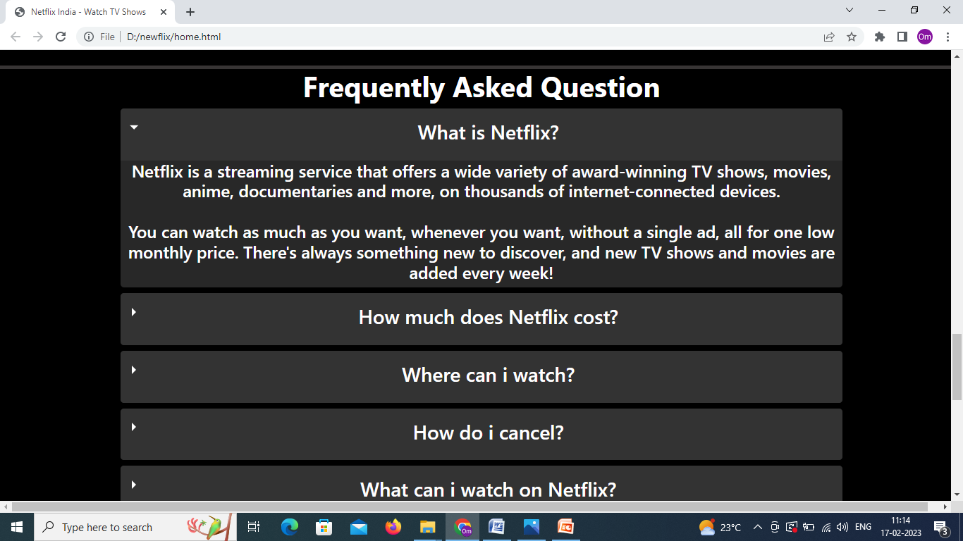
Content (6)

Slide 9
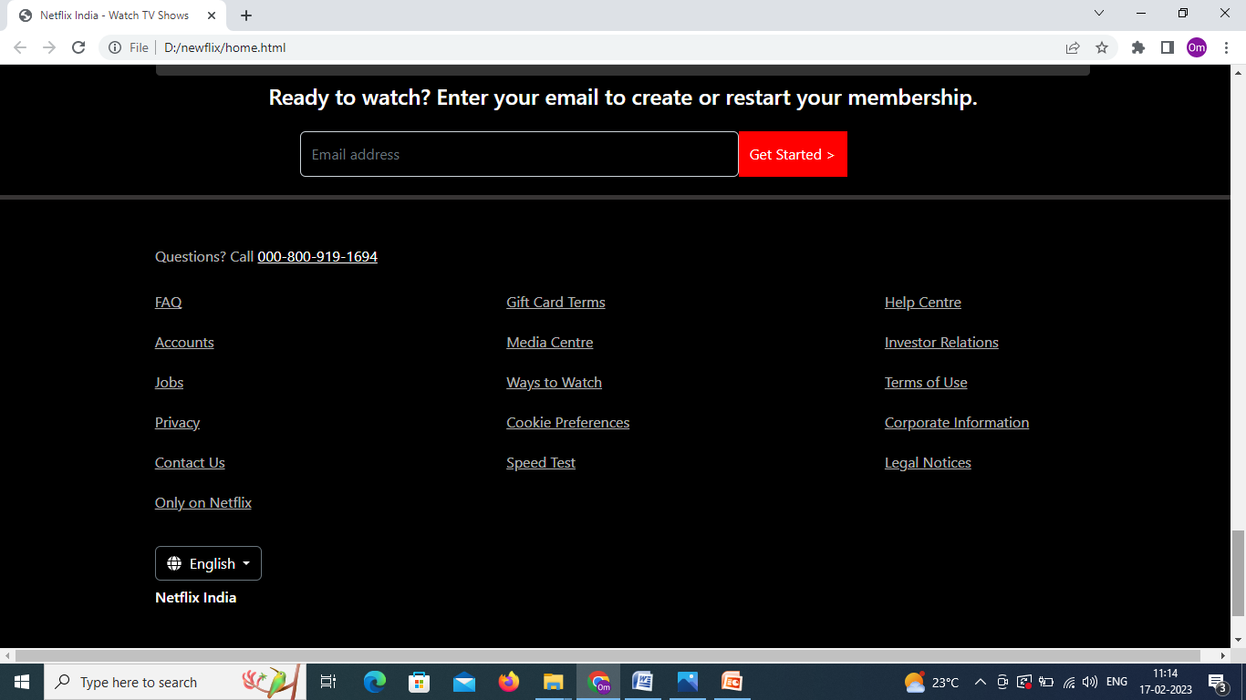
Footer

Slide 10
PPT Presentation Netflix
Thanks for watching
Shankar Hooda

